Slide 1
Heart Disease Prediction
Project Batch No : 9
Under the guidance of
Dommeti Varshitha - 22B01A4524
Mamidisetti Jnana Chandrika - 22B01A4556
Tadicharla Chandini - 23B01A4507
Mattaparthi Tejasri - 22B01A4562
Project Guide: Mrs.T.Madhavi
Designation :
Department : Artificial intelligence
Institution : Shri Vishnu Engineering college for women

Slide 2
Motivation
What motivated you to select this project
Heart disease is a major health issue worldwide, and
early prediction can help prevent complications
Explain with some scenario
A 45-year-old person has a family history of heart problems goes for a regular health check-up. A special system checks their health data, including cholesterol, blood pressure and some other features , and finds they are at high risk for heart disease or not this will possibly avoiding a heart attack in the future.

Slide 3
Objectives
What at least two or three objectives of your project
Early risk awareness: Help users understand their risk of heart
disease early, empowering them to take preventive actions.
Easy of use: Offer a simple interface for users to input their
data and get results quickly
Developing accurate models: To develop accurate models for
predicting heart disease

Slide 4
Literature Survey
Literature survey you did related to that problem statement
1. Research paper name: MDPI (2023)
Author : Prof. Nadikatla Chandrasekhar, Samineni Peddakrishna
2.Research paper name: Effective Heart Disease Prediction Using
Machine Learning Techniques (2023)
Author: Chintan M. Bhatt, Parth Patel, Tarang Ghetia and Pier
Luigi Mazzeo.
3.Research paper name: Machine learning–based heart disease
prediction system for Indian population(2022)
Published by: NIH (National Institution of Health)
4.Reacher paper name: Researchgate(2020)
Author: Prof. T.Chithambaram

Slide 5
Problem Identification
How you identified your problem
Reason for selecting it
Prevalence of Heart Disease: Heart disease is one of the
leading causes of death worldwide. Early prediction and
diagnosis can significantly reduce mortality rates by enabling
timely intervention.
Free Access to Predictions: The prediction model can be
provided at no cost to users, allowing them to assess their risk
for heart disease without paying for expensive tests or
consultations

Slide 6
Dataset Description
Number of Records:
The Data set contains the records 1,190
Number of Features:
The Data set Contain features 12 and they are :
Age
Gender
ChestPainType
Resting Blood Pressure
SerumCholesterol
FastingBloodSugar
Resting ECG
Max Heart Rate
Exercise Induced Angina
STDepresssion
SlopeSTSegment
HeartDiseaseDiagnosis

Slide 7
Data Set Description
Source of DataSet:
Our Data Set is taken form the National Institution of Health (NIH) named as Cardiovascular Diseases retrieved form Hospital in kerala.
Explanation of Each Feature of Data Set:
Age:
Observation from the Dataset:
High Risk Age Range: 50–70 years
Around 70% of patients with heart disease fall in this range.
Low Risk Age Range: Below 40 years
Less than 5% cases reported

Slide 8
Data Set Description
Gender:
Observation from the Dataset:
Male: 65% of heart disease cases.
Female: 35% of heart disease cases.
ChestPain Type:
Observation from the Dataset:
Typical Angina: Associated with the highest disease risk(~40%).
Atypical Angina: Moderate risk (~25%).
Non-Anginal Pain: Lower risk (~20%).
Asymptomatic Cases: Highest risk category (~50%).
Cholesterol Levels:
Observation from the Dataset:
Patients with cholesterol levels above 240 mg/dL have a significantly higher risk.
Cholesterol levels between 150–200 mg/dL are considered normal and are less correlated with disease.

Slide 9
Data Set Description
Exercise Induced Angina and Heart Rate:
Exercise Induced Angina:
Patients with exercise-induced angina show 45% higher heart disease prevalence.
Maximum Heart Rate:
Lower maximum heart rate achieved (below 120 bpm) correlates with higher risk.
Resting Blood Pressure and STDepression:
Resting Blood Pressure:
High blood pressure above 140 mmHg shows a significant correlation with heart disease.
Normal Blood Pressure 120 mmHg shows Low risk

Slide 10
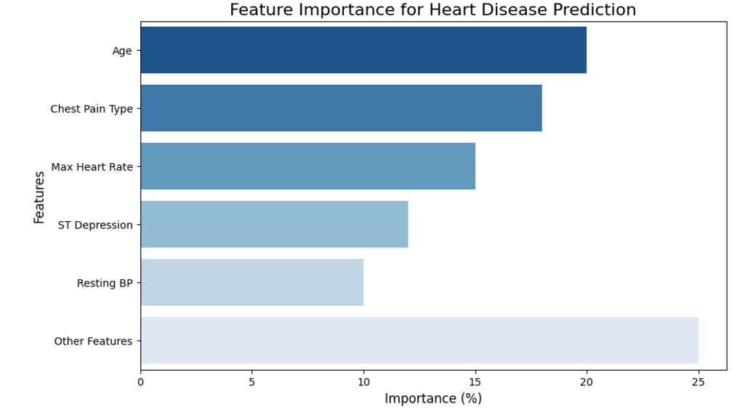
Data Set Description
Feature Importance in percentage using Bar chart:

Slide 11
Proposed Solution
Discuss about proposed solutions:
Data Preparation:
Cleaned and transformed data (e.g., encoded chest pain types, normalized features).
Removed outliers and handled missing values.
Feature Selection & Analysis:
Identified key predictors: chest pain type, age, exercise-induced angina.
Visualized patterns to understand feature relationships with heart disease.
Model Selection:
Used Random Forest Classifier for robustness and high accuracy.
Tuned hyperparameters (max_depth, n_estimators) for optimal performance.
Model Evaluation:
Metrics: Accuracy, Precision, Recall, F1-score, and ROC-AUC (0.97).
Confusion matrix and ROC curve helped assess reliability.
Discuss about approach adopted for your problem
Problem Framing: Binary classification task (predicting heart disease presence).
Exploratory Data Analysis (EDA): Bar plots and heatmaps identified trends.
Insights:
Age Range at Risk: 40-60 years.
Gender Risk: Males showed higher chances of heart disease.
Key Features: Typical angina, exercise-induced angina, cholesterol levels.
Validation: Evaluated using test data, achieving high performance and interpretability.
This systematic approach combines analytics and ML to provide actionable insights for early diagnosis.

Slide 12
Project Implementation Details
Discuss about preprocessing techniques adopted in the model
Data Cleaning: Renamed columns for consistency and readability.
Handled missing values using SimpleImputer and by dropping rows with excessive nulls.
Feature Transmition:
Target Variable Binarization: Converted HeartDiseaseDiagnosis into binary values (0 for no disease, 1 for disease) to simplify classification.
Categorical Encoding: Used get_dummies to one-hot encode categorical variables (e.g., ChestPainType, SlopeSTSegment) for algorithm compatibility.
Feature Scaling:Applied Standard Scaler to normalize continuous features like Age, RestingBloodPressure, SerumCholesterol, and STDepression to improve model performance.
Outlier Removal: Inspected distributions and removed outliers in critical numerical columns to ensure robust predictions.
Feature Mapping:Mapped categorical values to meaningful names, e.g., ChestPainType (e.g., 1 → Typical angina) and SlopeSTSegment.
Data Splitting: Used train_test_split to divide data into training (80%) and testing (20%) sets, ensuring unbiased evaluation.

Slide 13
Project Implementation Details
Discuss about algorithms used for your model:
Random Forest:
An ensemble learning algorithm combining multiple decision trees.
Chosen for its high accuracy, robustness, and ability to handle both categorical and numerical data.
Key Metrics: Achieved an AUC score of 0.97, indicating excellent performance.
K-Nearest Neighbors (KNN):
A distance-based algorithm that predicts outcomes by identifying the k nearest data points.
Used as a baseline model for comparison.
Naive Bayes:
Probabilistic classifier based on Bayes' theorem.
Effective for categorical features but less robust for highly correlated features.
Support Vector Machine (SVM):
A linear/non-linear classifier that uses hyperplanes to separate data.
Tuned kernel functions (linear, RBF) to test model performance.

Slide 14
Tools required
Software and hardware requirements of your project:
Software Requirements:
Operating System:
Windows 10/11, macOS, or Linux (Ubuntu recommended for better compatibility).
Python Version:
Python 3.6 or higher.
Libraries and Frameworks:
Django (for the web application interface)
Pandas (for data manipulation)
NumPy (for numerical operations)
Matplotlib & Seaborn (for data visualization)
SQLite (for database management)
Development Tools:
VSCode (for coding)
Jupyter Notebook (for model testing and development)
Hardware Requirements:
Processor:Intel Core i5 or higher for efficient computation.
Storage:At least 10GB of free disk space for software installation and dataset storage.

Slide 15
Timeline
Specify the time of your entire proejct

Slide 16
Learning Outcomes
List our your learning while doing this projects

Slide 17
Role of each project Member
Specify the role and responsibility of each member in the team

Slide 18
References

Slide 19
Thank you

